Slide 1
VISION 2030 Spring Deans and Chairs
Maximizing FSU’s Excellence

Slide 2
PRIMARY OBJECTIVE
The Vision 2030 initiative is designed to make us a better comprehensive research university. Through that process, we will develop a narrative that highlights the distinctive traits that will make us a strong AAU candidate.

Slide 3
WHAT IT MEANS TO BE AAU READY
AAU is an association of leading comprehensive research universities distinguished by the breadth and quality of their programs of a) academic research and scholarship and b) graduate education.
The primary purpose of AAU should be to provide a forum for the development and implementation of institutional and national policies promoting strong programs of academic research and scholarship and undergraduate, graduate, and professional education.
Membership is by invitation only.
AAU Indicators are divided into 2 Phases,
in a process that is 2 Stages.
Phase I + Phase II = Stage I
Stage II = more qualitative assessment of the
institution & its trajectory.

Slide 4
VISION 2030: AAU Indicators
Phase 1 Indicators
• Competitively funded federal research support
• Faculty awards, fellowships, and memberships
• Citations
• Books
Phase 2 Indicators
• USDA, state, and industrial research funding
• Doctoral education
• Number of postdoctoral appointees

Slide 5
VISION 2030 OPERATIONAL STRUCTURE
Executive Committee
President McCullough, Provost Clark, VP Patterson, SVP Clark, VP Kistner, VP Vickers, VP Hecht, Burnette
Steering Committee
Burnette + Team Leads + Trustee + Senate + Additional Stakeholders
SUPPORT TEAMS
OPERATIONAL TEAMS
Marketing
Research
Increasing Globalization
VP Lead: Vickers | Dean Lead: Farr/Fiorito Admin Leads: Barnhill, Susannah Wesley-Ahlschwede
VP Lead: Patterson | Dean Leads: De/Huckaba/Littles Admin Leads: F Alvi, B Hodges, E Pritchard
VP Lead: Provost Clark | Dean Lead: De Admin Leads: Steve McDowell, Rabieh Razzouk
Financing our Efforts
Awards & Recognition
Fine/Performing Arts & Humanities
VP Lead: K Clark | Dean Lead: Hartline Admin Leads: Michael Williams, Paul Harlacher
VP Lead: Kistner | Dean Lead : Wang Admin Leads: Peggy Wright-Cleveland, Sonja Carter
VP Lead: Vickers Dean Leads: Queen/Frazier/ Braddock Admin Leads: Jai Vartikar, Lynn Hogan
Data & Analytics
Citations/Books
Research Technologies/Computing
VP Lead: Provost Clark | Dean Lead: Andrew Admin Leads: James Hunt, Rashad Aziz
VP Lead: Kistner Dean Leads:Chapin/Etschmaier Admin Leads: Craig Stanley, Devin Soper
VP Lead: Patterson | Dean Lead: Kazmer Admin Leads: Fozard, Scott Stagg
Academic Innovation
Grad & Professional Programs
Community Engagement
VP Lead: Kistner Dean Leads: Blomberg
Admin Leads: Paul Marty, Ken Baldauf
VP Lead: Provost Clark | Dean Leads: O’Connor/Riley | Admin Leads: Riley and Joe O’Shea
VP Lead: Hecht | Dean Leads: Springer/Hanna Admin Leads: Jay Terry, Ursula Weiss

Slide 6
VISION 2030 PLAN
The plan is a campus-wide priority. Every stakeholder matters. We are adopting the same approach we use to attack performance-based funding and preeminence metrics, US News & World Report Rankings, and FSU’s Strategic Plan:
1
Determine an approach strategy and operationalize the approach
2
Mobilize stakeholders, assign team leads, empower teams to be successful
3
Assess FSU’s current research & graduate education status, identify tactics, and set ambitious goals
4
Create an accountability structure to keep people on task
5
Assess our progress frequently

Slide 7
Institutional Talking Points
Three Key Points the president used in his conversation with the AAU:
FSU is unlike most other R1s
Our institution has generated disproportional impact
FSU is building on over a decade of momentum with a recent pivot to rapidly expand our research portfolio and output.

Slide 8
Unlike Other R1s
History as Women’s college – creates diversity of programs with historic strengths in fine & performing arts, humanities, social sciences, education and Human Science juxtaposed on STEM and professional programs
HBCU Factor – Only Joint College of Engineering (HBCU partner)
Medicine and Engineering are relatively small and unique
Largest Centers are non-NIH – Mag Lab, LSI and FCRR
Rural Serving – Mission to translate research to underserved

Slide 9
Disproportionate Impact
Lower percent of faculty are research engaged
Taxol – Top commercialized invention treating > 1 million for cancer
Top 10 in non-science & engineering expenditures
Top 20 NSF funded institution
LSI created South Korea’s education system and other systems and programs around the world
First College of Entrepreneurship
National leader in student success – graduation rates and CARE
Multiple recent awards for International Education and Globalization

Slide 10
MOMENTUM
Institutional focus on student success due to performance funding
Great success in moving up from 43 to top 25 in US News rankings
Pivot with new president and cabinet
Research expenditures up 28% in two years
FSU Health - $125M investment and growth of clinical services and research
College of Nursing - >$100M in grants and #1 college for research expenditures
InSPIRE Project - $98.4M for Aerospace and Advanced Manufacturing
Focus on STEM hires with new investments in Quantum Sciences and Data Science
Building our core mission of serving the people of Florida

Slide 11
FSU & AAU Metrics

Slide 12
FSU’s Relative Position on AAU Metrics
The following charts show FSU’s 2022 performance (in Gold) versus the AAU institutions invited to join in the past ten years – calculated as per capita/faculty measures (where applicable)
Where available, we also include 2023 data for FSU (in garnet)
Some measures include quartile views with 1 being the worst (For scaling issues, we don’t include all AAU institutions in each visual)
We will continue to generate additional data views so we can represent them at the program/department level where possible

Slide 30
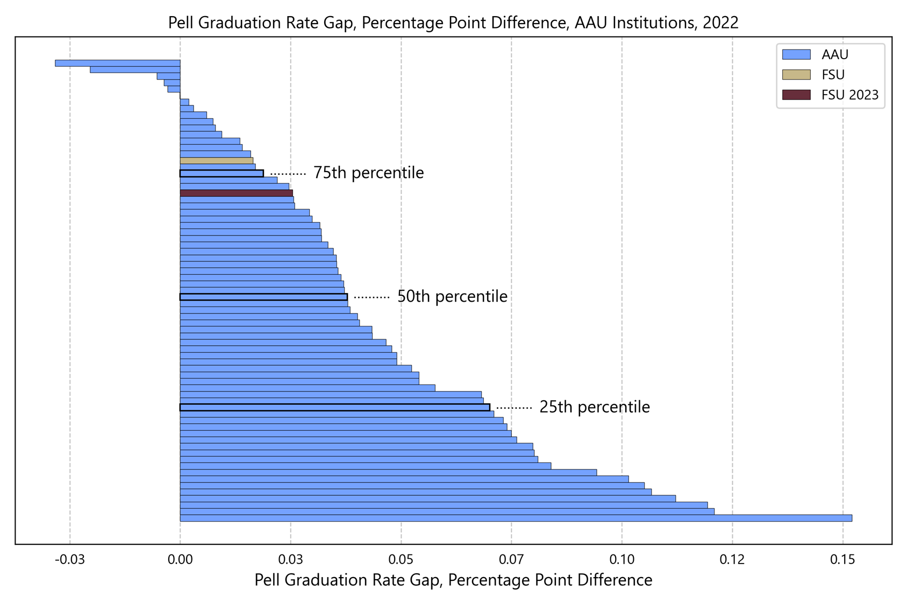

Slide 31
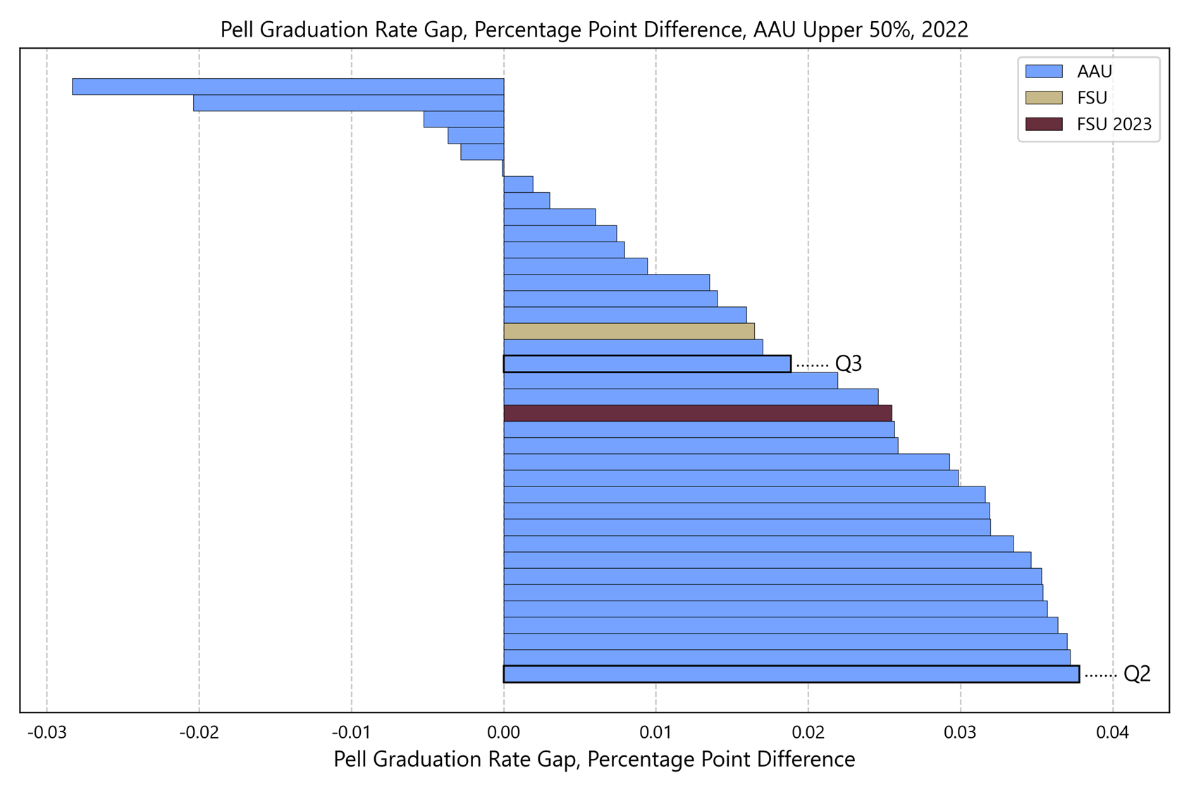

Slide 33
Where we Need to be on Metrics
We will continue to track institutional metrics

