Slide 1
Research Update
Deans and Chairs Meeting
April 2, 2024

Slide 2
Notes:
Florida State University has named acclaimed researcher and industry leader Kathleen Amm as the new director of the National High Magnetic Field Laboratory (National MagLab), the largest and highest-powered magnet laboratory in the world and the only facility of its kind in the United States.
Dr. Amm, who currently serves as director of the Magnet Division at Brookhaven National Laboratory (BNL), will begin her tenure as lab director on May 6. Selected as the result of an international search, Dr. Amm earned her doctorate from FSU in 1998 and was advised by the National MagLab’s founding director, Jack Crow, during the early days of the formation of the National MagLab’s headquarters at Florida State University.
“We are delighted to welcome Dr. Amm back to Florida State University to lead the National High Magnetic Field Laboratory,” said FSU President Richard McCullough. “She has a proven record of success, and we are confident that her leadership, expertise and vision will usher in a new era of scientific excellence at the National MagLab.”
With primary funding from the U.S. National Science Foundation (NSF) and State of Florida, the National MagLab comprises more than 500,000 square feet at its Florida State University headquarters, plus locations at the University of Florida (UF) and Los Alamos National Laboratory (LANL). The National MagLab hosts researchers from hundreds of universities, labs and businesses from around the globe who use unique high-field magnets and instrumentation to answer pressing questions in health, energy, materials, quantum science and more.
Dr. Amm will oversee more than 500 scientists/employees and more than 2,000 visitors from across the United States and dozens of countries each year.
“I am elated to be returning to my alma mater to run the world’s largest and highest-powered magnet lab,” Dr. Amm said. “I believe the National MagLab’s people represent the lab’s greatest opportunity, and I am excited to work with the brilliant scientists and staff to develop a compelling vision for the future of high-field magnet science and technology.”
Dr. Amm will succeed current director Gregory Boebinger, who announced his intent to step down last year. Boebinger has elevated the National MagLab during his 20-year tenure as director and will remain at Florida State as a faculty member in physics.
“Dr. Amm brings decades of experience in high-field magnet research and development – both in industry and in a national lab setting,” said FSU Vice President for Research Stacey S. Patterson. “She will excel in this role and help realize the National MagLab and Florida State’s shared goals of advancing materials, building a resilient future and developing new health technologies.”
At Brookhaven National Laboratory, Dr. Amm leads a team of scientists, engineers and technicians developing the future of superconducting magnet technology.
Prior to Brookhaven, she spent nearly 20 years at GE Global Research, first as a physicist in the electromagnetics and superconductivity lab, before moving into various leadership positions across the organization.
Dr. Amm has a long track record of innovation in the field of magnet technology. She holds 22 patents and has co-authored more than 75 peer reviewed publications. In 2014, GE Global Research recognized her contributions to breakthrough magnet technologies. She is a member of several professional societies and senior member of the Institute of Electrical and Electronics Engineers.
As National MagLab director, she will oversee operations at the Florida State University headquarters and the lab’s satellite locations at the University of Florida and Los Alamos National Laboratory.
The University of Florida hosts two unique National MagLab user facilities for materials research and biochemical work. Ultra-low temperatures in a reduced electromagnetic noise environment are provided to probe quantum materials at temperatures near absolute zero (0.4mK) and powerful nuclear magnetic resonance and magnetic resonance imaging tools are available as part of the McKnight Brain Institute.
“UF welcomes Dr. Amm to the National MagLab,” said David Norton, Vice President for Research at the University of Florida. “She brings extensive experience in complex projects and partnerships, and we look forward to her work with the unique research facilities that UF brings to the National MagLab portfolio.”
The Los Alamos National Laboratory hosts the National MagLab’s Pulsed Field Facility, which provides access to the world’s strongest pulsed fields, up to 100 tesla powered by a 1.4 gigawatt motor generator.
“Dr. Amm is a respected leader from a fellow Department of Energy-funded national lab (BNL),” said Ellen Cerreta, LANL’s Associate Laboratory Director for Physical Sciences. “This new role directing the National MagLab is a continuation of her strong support in service to the nation’s highest scientific goals.”
The National High Magnetic Field Laboratory has been headquartered at Florida State University since 1994. Since that time, more than 25,000 researchers have conducted experiments from the National MagLab and the work done there has yielded more than 9,600 publications, over 200 book chapters and more than 100 patents.
NSF announced a new five-year cooperative agreement in 2022 to support the National MagLab as one of its major facilities .
“The U.S. National Science Foundation is a proud supporter of the National MagLab and is excited to see the groundbreaking science discoveries and technological advances ahead during Dr. Amm’s tenure,” said Germano Iannacchione, Director of NSF’s Division of Materials Research, the steward of the National MagLab’s operation award.
For more information on the National MagLab, visit nationalmaglab.org.

Slide 3
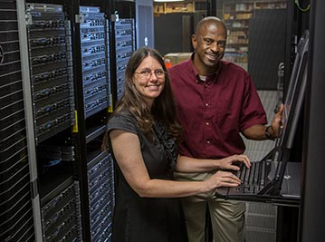
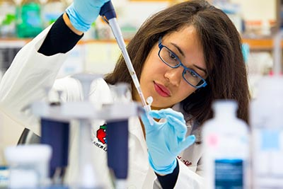
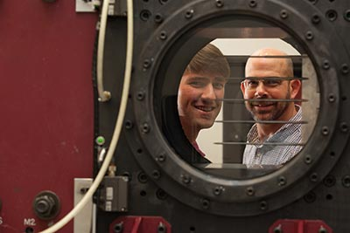
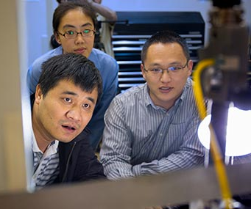
RESEARCH
NATIONAL SCIENCE FOUNDATION
Highest funding in Florida
NATIONAL INSTITUTES OF HEALTH
Area of fucus for targeted growth
$75.4M in 2023
$45.5M in 2023
$414.4M Total Research Expenditures

Slide 4
TOTAL RESEARCH
$450
$400
$350
$300
$250
Millions
Year
Notes:
FSU research expenditures increased 12% over FY22 setting an all-time high

Slide 5
FEDERAL RESEARCH
$200
$175
Millions
$150
$125
$100
Notes:
FSU has grown 49% in federal funding since 2016

Slide 6
Awards
YTD February 29th FY23 vs. FY24
$695.4M
352
951
$216M
Initial
Award Count
Proposal Count
Proposal Amount
Award Amount
11%
33%
5.4%
14%

Slide 7
SRAD Distributions and Uses
Expenses | Percent Allocation (actuals FY 23)
ASSESSMENTS | 2.7%
SPACE & INFRASTRUCTURE | 7.3%
RESEARCH SUPPORT | 11.3%
RESEARCH ADMINISTRATION | 25.5%
SCHOOLS /COLLEGE & DEPARTMENT DISTRIBUTION | 30%
CENTER FOR RESEARCH & CREATIVITY (CRC) | 7.5%
OVPR RESEARCH SUPPORT | 16%
TOTAL | 100.3%

Slide 8
Identify strategic areas of focus and investment to ensure FSU’s burgeoning research enterprise has sustainable impact for our future.
Notes:
With our ambitious goals in research, scholarship and creative endeavors, ASPIRE will help us identify those strategic areas of focus and investment to make sure we have sustainable impact. I want to clear…ASPIRE is the “what” and we still have much work to do on the “How”

Slide 9
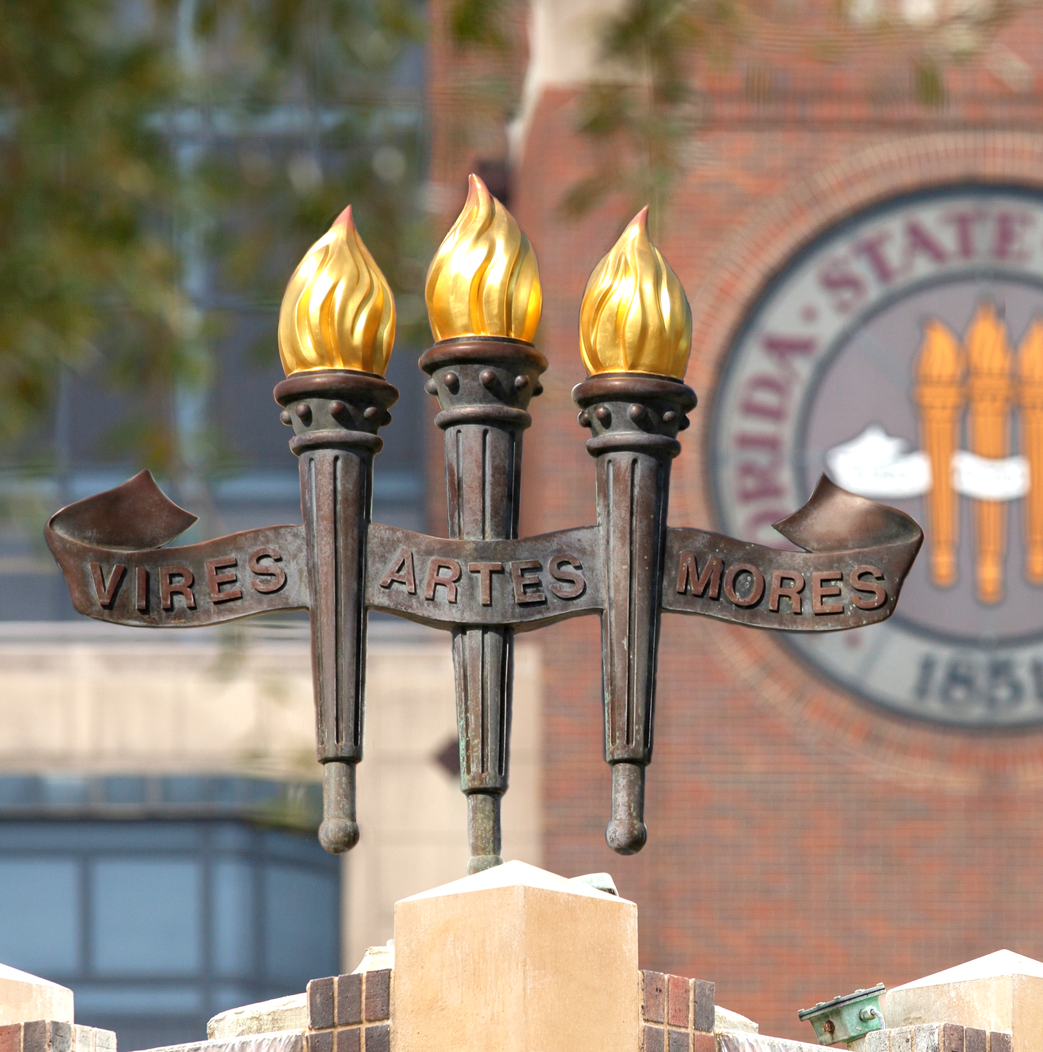
HEALTHY FLORIDA | ADVANCING MATERIALS | A RESILIENT FUTURE
SMART DATA | HUMAN IMPACT

Slide 10
TRANSLATIONAL RESEARCH
Institution | Invention Disclosures | Licenses | Startups
University of Florida | 361 | 269 | 12
University of Central Florida | 118 | 28 | 4
University of South Florida | 191 | 100 | 11
University of Georgia | 183 | 175 | 6
Florida State | 55 | 21 | 2

Slide 11
The ART grant was awarded to Florida State University on September 15, 2023. Total funding is $5,992,383 for this four-year project. Project started February 1, 2024.

Slide 12
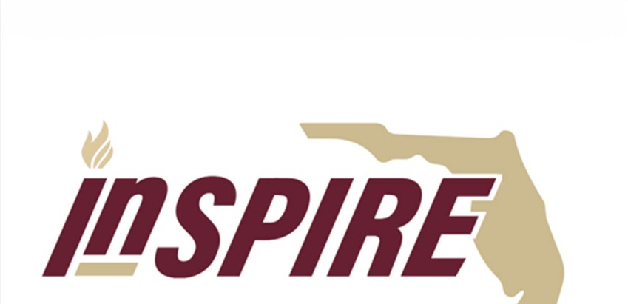

Slide 14
Senate Bill 846 BOG Regulation 9.012
Foreigninfluencecompliance@fsu.edu

Slide 16
Arts
Sciences
Medicine
Nursing
Engr
Human Sciences
Social Work
SSPP
CCI
Business
Clinical Partners
Industry
Partners
Tallahassee Memorial Healthcare
Tallahassee Orthopedic Clinic
Mayo Clinic of Florida
Andrews Institute
Capital Health Plan
3000+ Clinical practice affiliates around the state

Slide 17
EDUCATION
Medical school, GME, CME, CE, Undergraduate and Graduate programs and internships
Imagine the Possibilities.
RESEARCH
Accelerating Discovery
Leveraging Technology
Engaging the Community
Patient-centered Deployment
CLINICAL CARE
Connect the continuum of care
Reach patients at home
Attract local workforce talent

Slide 18
By combining our strengths, we can have a measurable impact on healthspan and access in Florida
Establish a cohesive team of leaders, researchers, and clinicians to impact health and wellness across Florida
Expand our research capacity and expertise within our clinical communities and beyond—leading to more papers, more proposals, more grant awards, more innovation to help patients
Increase connections to share knowledge, collaborate, and refer patients for continuity of care
Create an ecosystem of collaboration and innovation that will lead to developments in health technology solutions, economic development and commercialization opportunities
Notes:
The synergistic relationship between Tallahassee and Panama City will help us establish an ecosystem for creativity, scholarship, and innovation as drivers to deliver healthcare to all.

Slide 19
ACADEMIC LEADERS
Medical, Nursing, Allied Health
RESEARCH LEADERS
Biomedical & Translational
RESEARCH LEADERS
Clinical & Translational
INNOVATION LEADERS
Commercialization
LOCAL LEADERS
Regional
Connections
Primary Care
Specialty Care
Regional Hospital
Tertiary/Quaternary

Slide 20
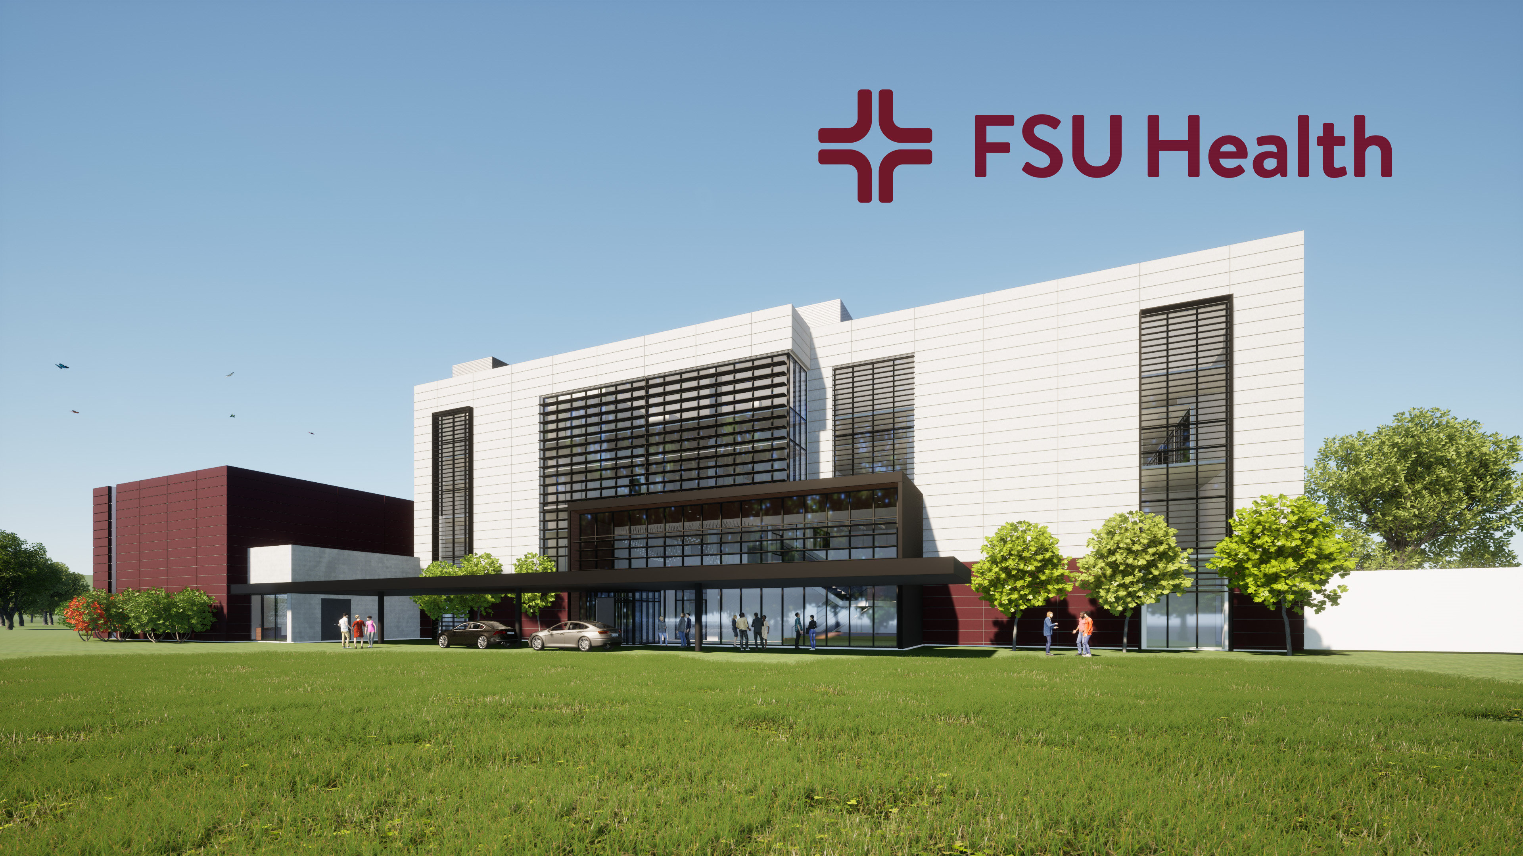

Slide 21
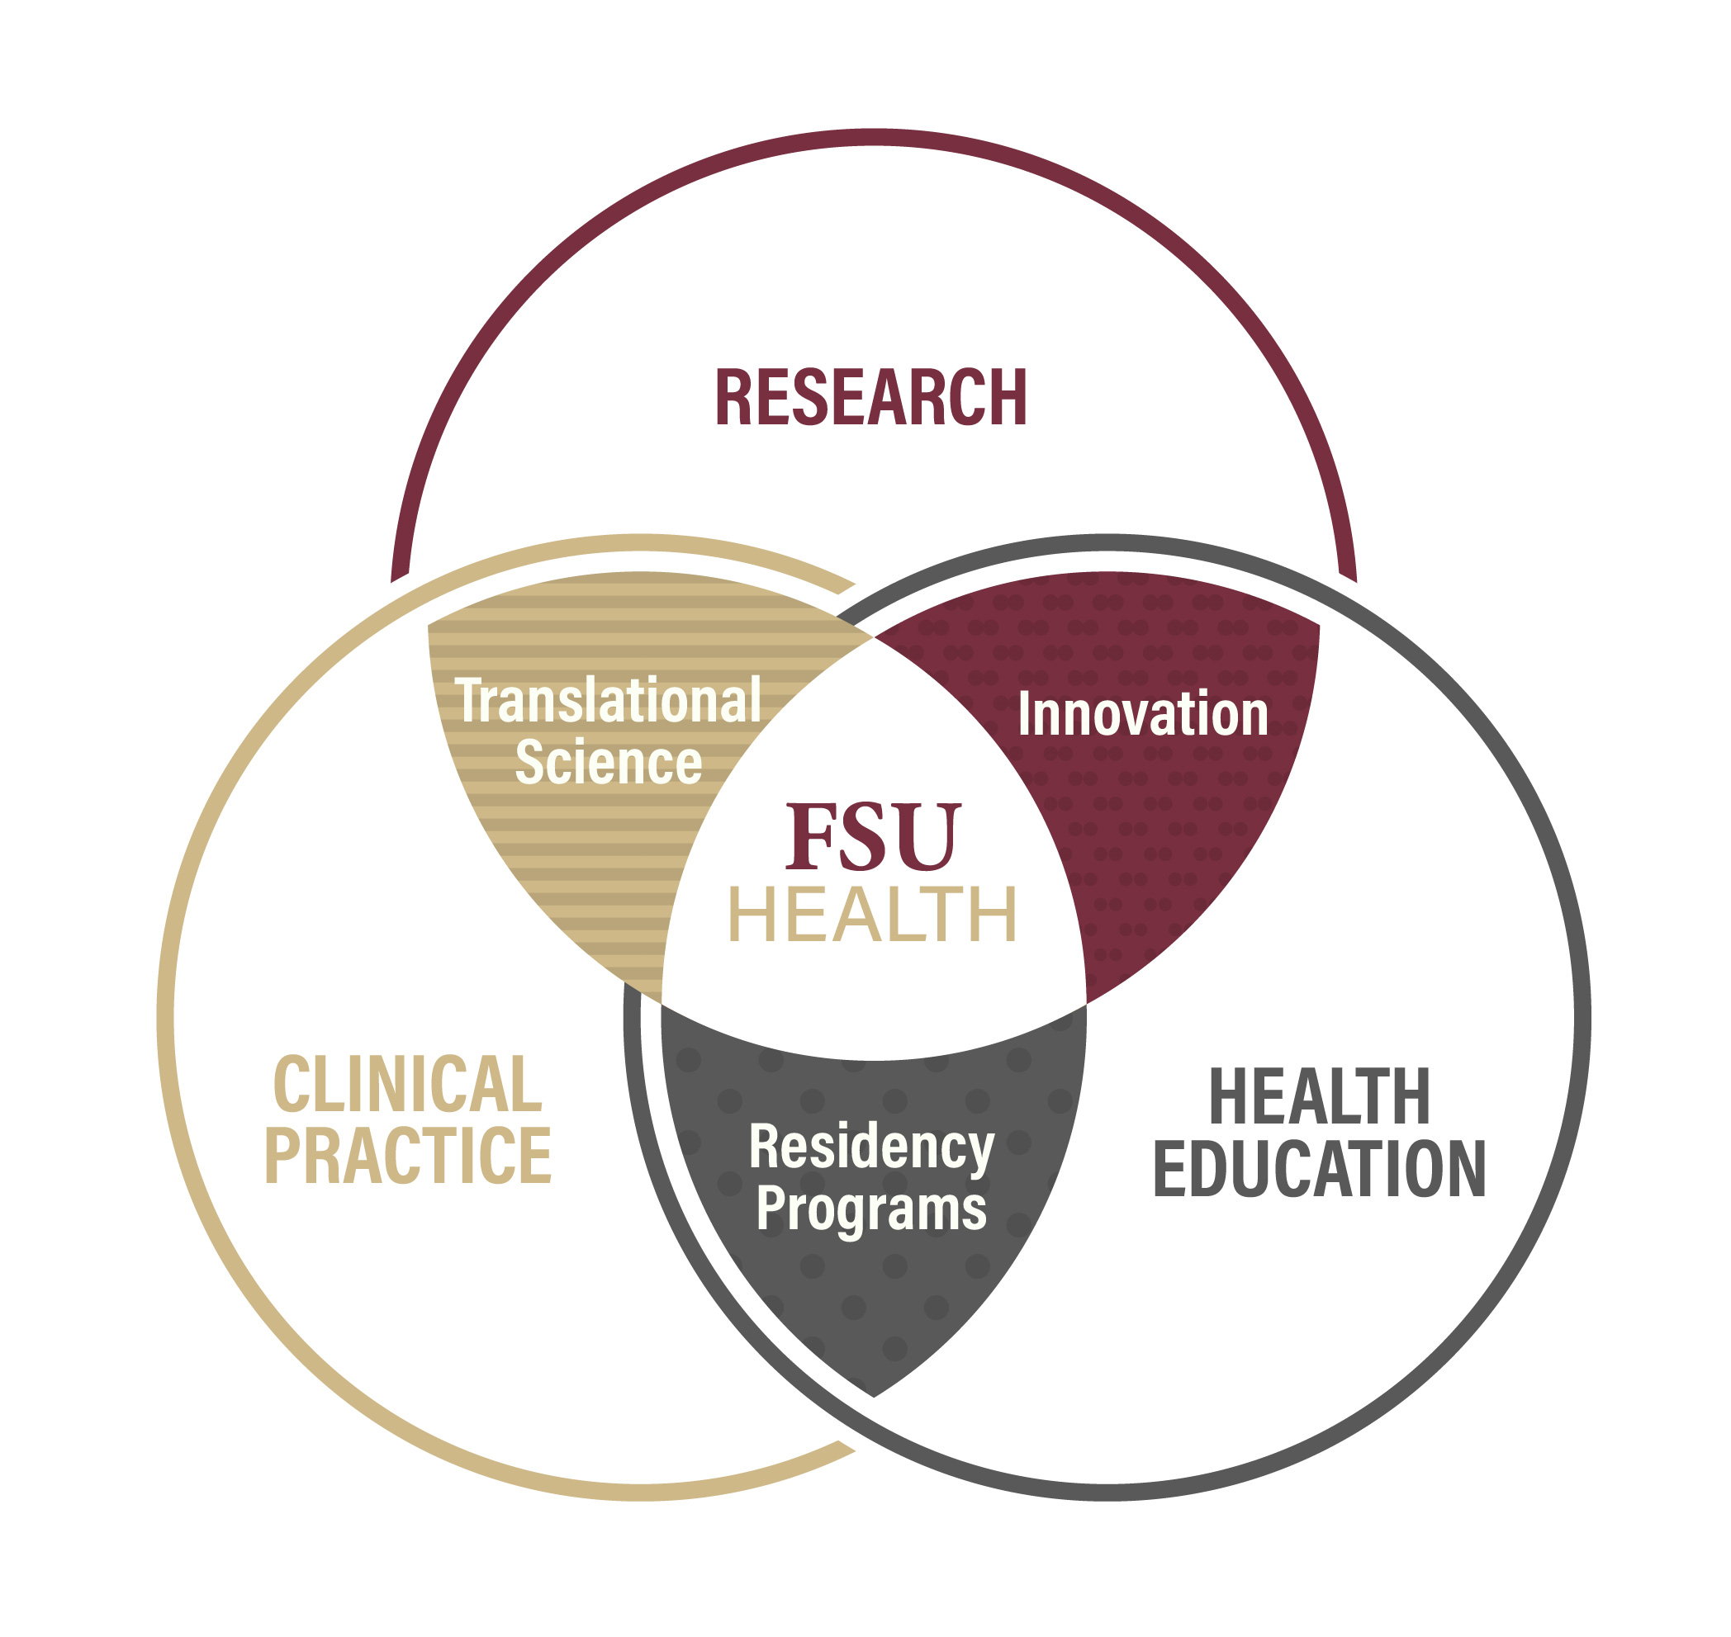
LET’S CONNECT!
Notes:
I want to reiterate that FSU Health is a critical part of our vision.
It’s our responsibility to meet community needs, and the need is there. There are large populations of underserved people across the region, and federally designated medically underserved areas in every county in North Florida. We know the area has been affected by hurricanes and economic challenges and there are large aging and rural populations that have historically had less access to high quality healthcare. FSU Health is an opportunity to reimagine team-based healthcare in the region.
We can increase FSU’s impact through a holistic approach to rural health and aging population. This will benefit our community and the state, and increase access for those who need healthcare most. This aligns with TMH's strategic goal to provide the best patient-centered quality of care.
Reputationally, FSU Health helps solidify FSU as a leader in STEM, health and translational science, which may help us gain American Association of Universities (AAU) membership, attract the best faculty and students, and continue to grow our national ranking.
And FSU Health will help us win additional NIH funding, which leads to more research and the ability to help more people.

Slide 22
Thank you!
Imagine the Possibilities.

