Slide 1
CIO Update
Jonathan Fozard

Slide 2
Ransomware explained
COLLEGE
“A”
COLLEGE
“B”
BAD ACTORS
TECHNOLOGY INFRASTRUCTURE

Slide 3
Ransomware explained
COLLEGE
“A”
COLLEGE
“B”

Slide 4
Ransomware explained
COLLEGE
“A”
COLLEGE
“B”

Slide 5
Ransomware explained
COLLEGE
“A”
COLLEGE
“B”

Slide 6
Ransomware explained
COLLEGE
“A”
COLLEGE
“B”

Slide 7
Ransomware explained
COLLEGE
“A”
COLLEGE
“B”

Slide 8
Ransomware explained
COLLEGE
“A”
COLLEGE
“B”

Slide 9
Ransomware explained
COLLEGE
“A”
COLLEGE
“B”

Slide 10
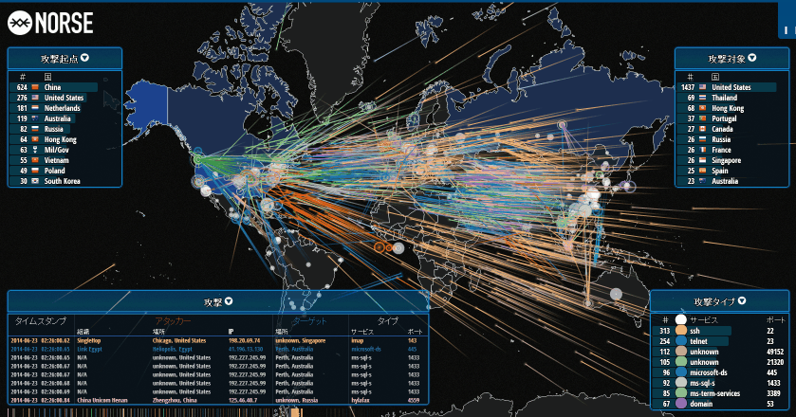
“It’s not A question of IF a cybersecurity incident will take place, it Is only a question of WHEN, where, and how well our areas have prepared.”
- Bill Hunkapiller Chief Information Security Officer

Slide 11
CIO Summary & next steps
Distributed IT areas cannot accept risk on behalf of the University.
Institutional technology policies are not optional (i.e., Central EDR protection is required, separate email systems, networks, active directory, etc.).
Technology alignment will be further reviewed with the Provost and Deans in 2024-2025.

