Slide 1
Spring 2024 Deans and Department Chairs Meeting
Renisha Gibbs • Associate Vice President for Human Resources/ Finance & Administration Chief of Staff
April 2, 2024

Slide 2
Fair Labor Standards Act
Department of Labor Proposed Rulemaking

Slide 3
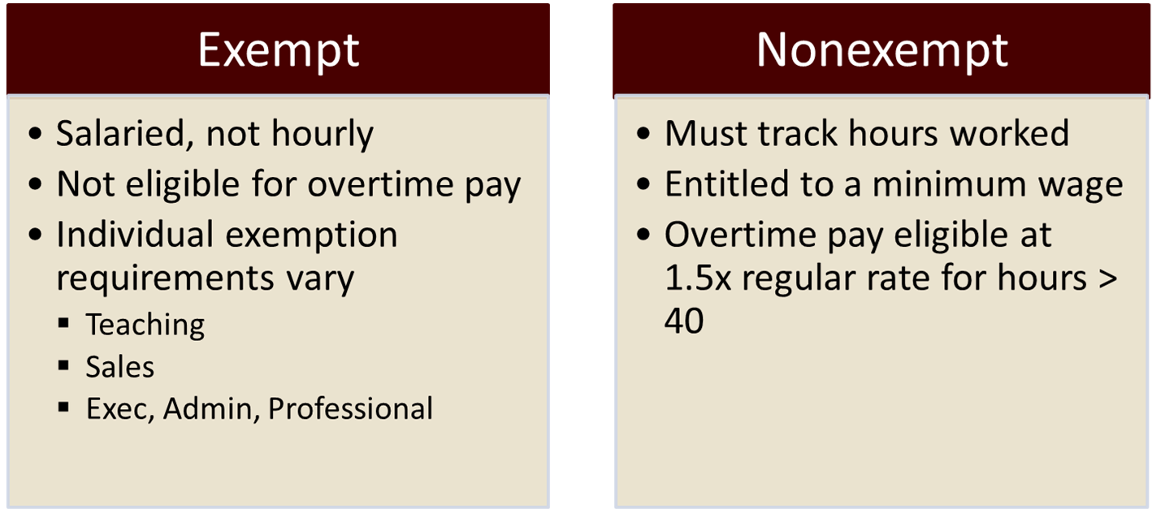
FLSA
Overview
Department of Labor
Fair Labor Standards Act (FLSA)
Establishes federal minimum wage and overtime pay standards.
Notes:
Establishes federal minimum wage and overtime pay standards.
Requires the employer to track non-exempt employee hours and pay a premium “overtime rate” of 1.5 times the employee’s regular pay rate for hours worked over 40 per workweek.
Contains various exemptions to overtime requirements, including for employees whose primary duties are Teaching, Sales, or Executive, Administrative, and Professional (EAP).

Slide 4
FLSA
Current Requirements
Employees under the Executive, Administrative, and Professional (EAP) exemption must meet a three-part test:
Salaried
Must be paid on a salary basis – not hourly
Duties test
Perform primarily executive, administrative, or professional duties as defined under DOL regulations
Salary Threshold
Earn more than $684/week ($35,705 annually at FSU)
Notes:
Employees under the Executive, Administrative, and Professional exemption, or “white collar” exemption, must meet a three-part test:
Must be paid on a salary basis – not hourly
Duties test
Perform primarily executive, administrative, or professional duties as defined under DOL regulations
Must meet minimum salary level (calculated on weekly earnings)
Earn more than $684/week ($35,705 annually at FSU

Slide 5
FLSA
Proposed Rule Changes
Impacting the Executive, Administrative, and Professional Exemption:
Salaried
No changes expected.
Duties test
No changes expected.
Salary Threshold
Ties minimum to the 35th percentile of weekly earnings in the lowest-wage Census Region (South).
May adjust again before a final rule is posted.
Includes automatic updates to the salary level every three years.
Notes:
May adjust to 60K in final ruling.

Slide 6
FLSA
Rulemaking Timeline
September 8, 2023 - Notice of Proposed Rulemaking (NPRM) published to the Federal Register for 60-day public comment period.
November 7, 2023 – Public comment period closed. Dept of Labor reviewing over 33,000 comments.
April 2024 – Final rule is expected. Anticipate at least 60 days for implementation.
*Similar to 2016: Expect legal challenges regarding the DOL’s authority to impose a salary threshold increase, as well as the authority to implement automatic updates to the threshold.
Notes:
DOL must review and respond to all substantive comments before publishing a final rule, which will include an implementation date. President must sign the final rule. Implementation date could be as early as 60 days after a final rule is published.
Final rule expected Spring 2024 for summer implementation due to upcoming election season. Previously, effective date was 6 months after final rule was posted.
*Similar to 2016: Expect legal challenges regarding the DOL’s authority to impose a salary threshold increase, as well as the authority to implement automatic updates to the threshold.
Previous effective date for 2016 NPRM was 6 months after the final rule was posted.

Slide 7
FLSA
Impact by Employee Type
 | Current FLSA Status | Proposed FLSA Status
Teaching Faculty All Tenure-track & Specialized Teaching roles | Exempt | No impact.
Non-Teaching Faculty Specialized/Researchers/Admin | Exempt | UNDER REVIEW.
Post-docs | Exempt | UNDER REVIEW.
Graduate Assistants | Exempt | No impact.
A&P Exempt | Exempt | UNDER REVIEW.
USPS Exempt | Exempt | UNDER REVIEW.
USPS Nonexempt | Nonexempt | No impact.
OPS Exempt | Exempt | UNDER REVIEW.
OPS Nonexempt | Nonexempt | No impact.
Notes:
Teaching – Employees whose primary duties are teaching/instructing or lecturing are exempt based on duties. Do not have to meet the salary threshold test.
Most Faculty are covered. All tenure stream. Specialized Faculty who teach.
GAs – not affected by proposed changes. Primary relationship = student, not employee. Not subject to duties or salary test.
Non-Teaching Faculty = Librarians, Researchers, Administrators – all must meet salary threshold.
Post-docs -
Recommendations for how to address impact are currently under review with the strategy committee - If we were to raise ALL, it would be over 10m based on the current proposed guidelines.

Slide 8
FLSA
Under Review
FLSA Strategy Committee currently reviewing data and recommendations that consider the following:
External market value
Helps determine which classifications remain exempt.
Not all currently exempt roles warrant a minimum starting salary of $55k-$60k.
Internal market
Existing and potential salary compression
Part-time employees
DOL does not prorate for FTE or hours worked.
Those who do not meet the published weekly salary requirement will be impacted.
Financial and Administrative Impact
Cost to Raise vs Overtime
Complexity of Scheduled Work Hours

Slide 9
FLSA
FLSA Strategy Committee
Renisha Gibbs, Chair
Caroline Poole, University Advancement
Cindy Hartmann, Athletics
Craig Stanley, Faculty Development & Advancement
Joe O’Shea, Undergraduate Studies
Jonathan Fozard, Information Technology Services
Kerry Peluso, Research
Lisa Scoles, General Counsel
Mark Riley, Graduate School
Michael Williams, Finance & Administration
Paul Harlacher, Academic Affairs
Sam Huckaba, Academic Affairs
Zduy Chu, Student Affairs

Slide 10
FLSA
Next Steps
If the current proposed rule is implemented, the University will be impacted.
Continue to monitor Federal Register, awaiting final rule.
Reviewing potential impact and recommendations in partnership with University FLSA Strategy Committee.
More communication to come.
Salary determinations for new staff hires and pay increases will still follow compensation practices, utilizing job code salary ranges and external market data.

